Slide 1

Chapter 11
Reproductive Health

Slide 2
Reproductive Health and Global Health
11.1

Slide 3
Reproductive Health
Reproductive health encompasses issues of fertility and infertility, contraception, pregnancy and childbirth, gynecologic and urologic health, and the prevention and treatment of sexually transmitted infections.
Maternal and child health (MCH) programs focus on helping babies and young children get their healthiest start in life.
The healthiest babies are born to women who were healthy before they conceived their offspring, who had access to preventive health services during pregnancy, and who had skilled birth attendants assist with delivery and the postnatal period.
All adults and adolescents need to have access to reproductive health care and the tools to maintain their reproductive health.

Slide 4
Reproductive Health (cont’d)
Sustainable Development Goal (SDG) 3 focuses on health, and SDG target 3.7 is to “ensure universal access to sexual and reproductive health-care services, including for family planning, information, and education, and the integration of reproductive health into national strategies and programs.”

Slide 5
Reproductive Rights
SDG 5 focuses on gender equality, and SDG target 5.6 is to “ensure universal access to sexual and reproductive health and reproductive rights as agreed in accordance with the Programme of Action of the ICPD and the Beijing Platform for Action and the outcome documents of their review conferences.”
  The International Conference on Population and Development (ICPD) was a United Nations (UN) meeting (held in Cairo, Egypt, in 1994) that emphasized reproductive rights, calling for women and their partners to have the freedom to decide how many children they want without interference from governments or other organizations.
  The Beijing Platform for Action was the result of the 4th UN World Conference on Women (held in China in 1995) that vigorously advocated for gender equality and women’s empowerment.

Slide 6
Reproductive Rights (cont’d)
Significant progress toward reducing the number of women who die in childbirth each year, increasing access to the tools for family planning, and protecting the rights of women have been made in the 20 years since those landmark UN conferences.
Reproductive health remains a hot topic in global health because there is not unanimous agreement on the value of reproductive rights, contraceptive use, and gender equity.

Slide 7
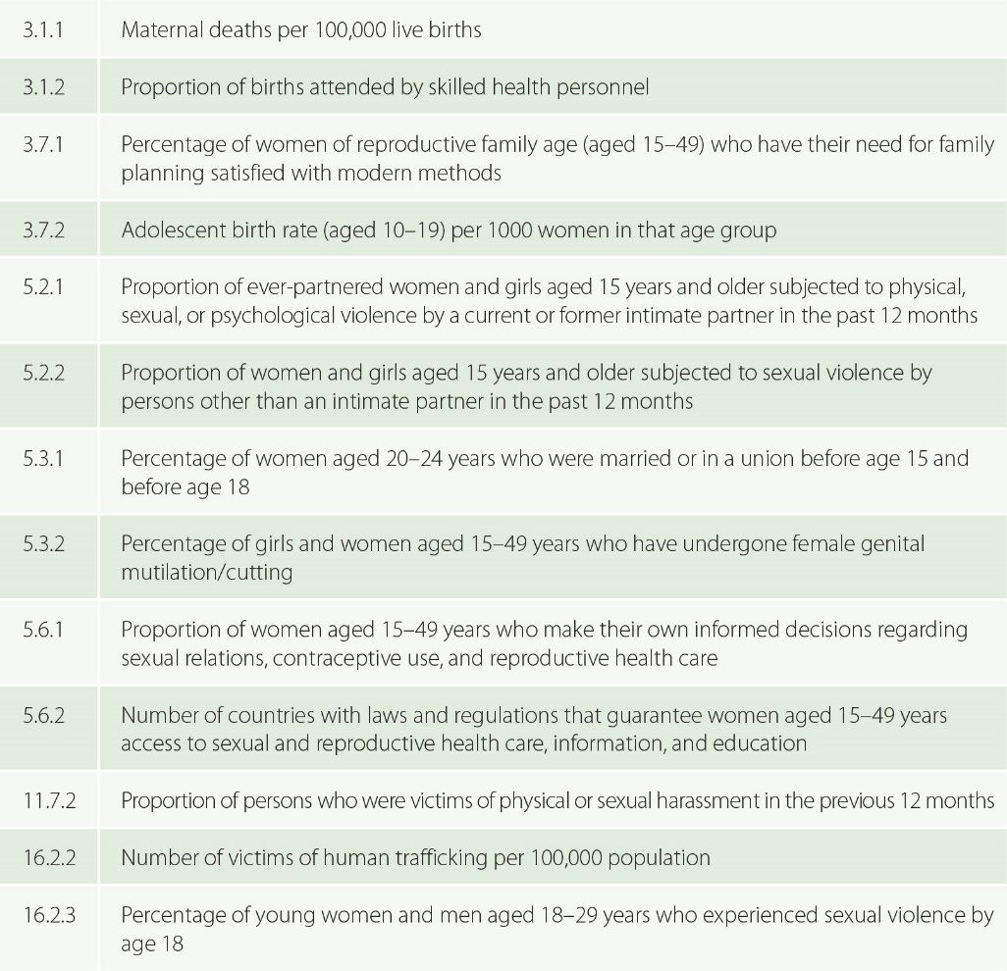
Figure 11-1
Data from United Nations Economic and Social Council. Report of the Inter-Agency and Expert Group on Sustainable Development Goal Indicators (E/CN.3/2016/2/Rev.1). New York: UN; 2016.
Examples of Sustainable Development Goals (SDG) targets related to sexual and reproductive health.

Slide 8
The Fertility Transition
11.2

Slide 9
Demographic Transition
Demography = the study of the size and composition of human populations.
Demographic transition = a shift toward lower birth and death rates that often occurs as populations move from being lower-income economies toward being middle-income and then higher-income economies.
Fertility transition = a reduction in the average number of offspring the typical female gives birth to.

Slide 10
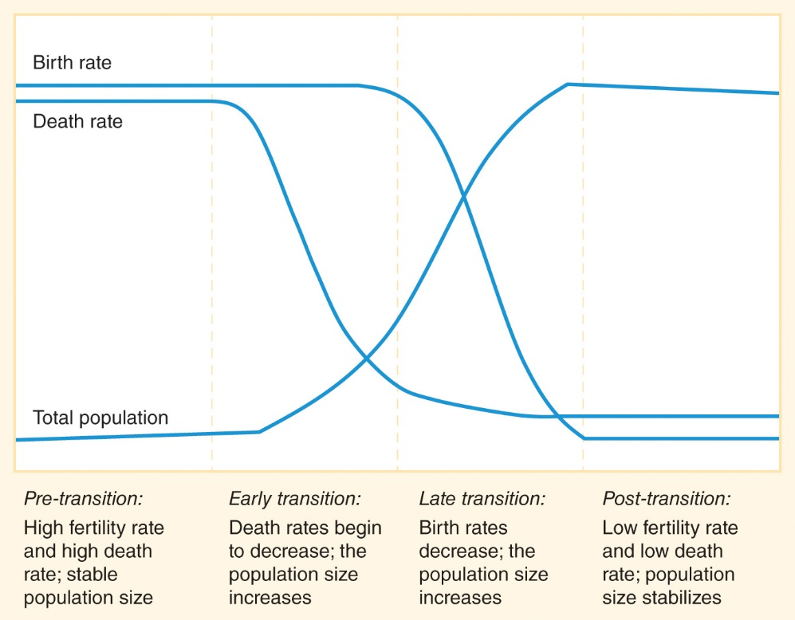
Figure 11-2
The fertility, mortality, and demographic transitions

Slide 11
Fertility Rate
Fertility rate = the average number of children a woman gives birth to during her childbearing years.
Countries with high fertility rates have a high percentage of children in their populations, while countries with low fertility rates have about as many older adults as children in their populations.

Slide 12
Fertility Rate (cont’d)
Replacement population = each woman has, on average, about 2 children, so those 2 parents will produce 2 offspring, “replacing” themselves but not increasing the size of the population.
  If the total fertility rate is greater than 2, then the size of the population will increase over time.
  If the fertility rate is less than 2, then the number of people in the total population will begin to decrease.
The fertility rate has decreased significantly in recent decades in most countries, but the fertility rates remain higher in low-income countries than in high-income countries.

Slide 13
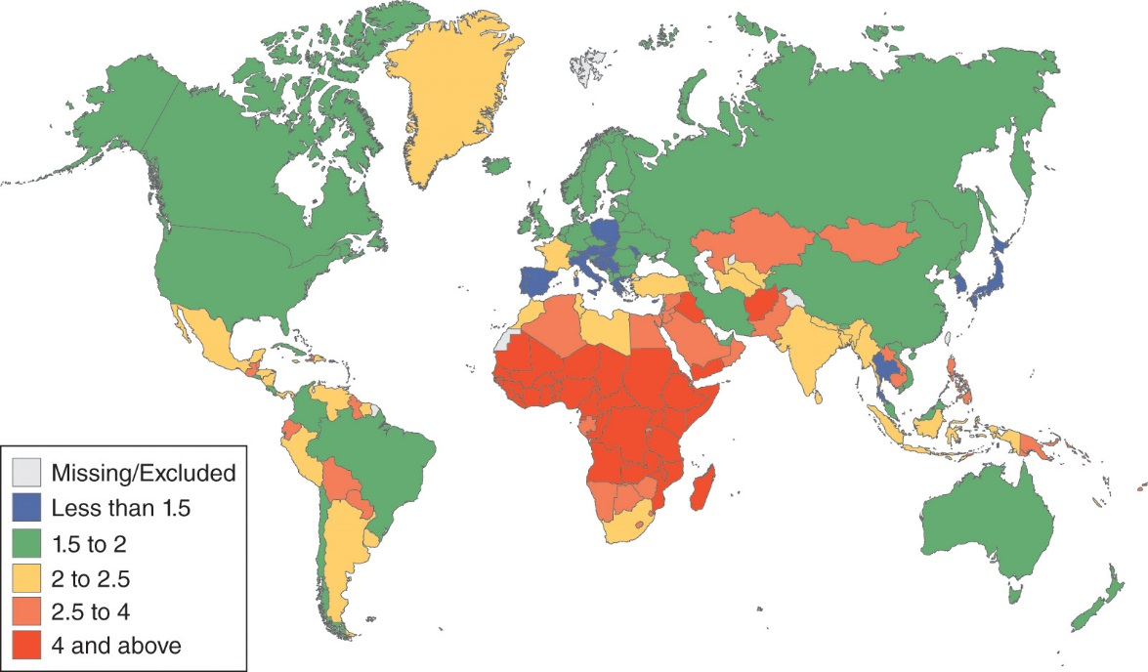
Figure 11-3
Data from Human development report 2016. New York: UNDP; 2015.
Total fertility rate (births per woman) (2015).

Slide 14
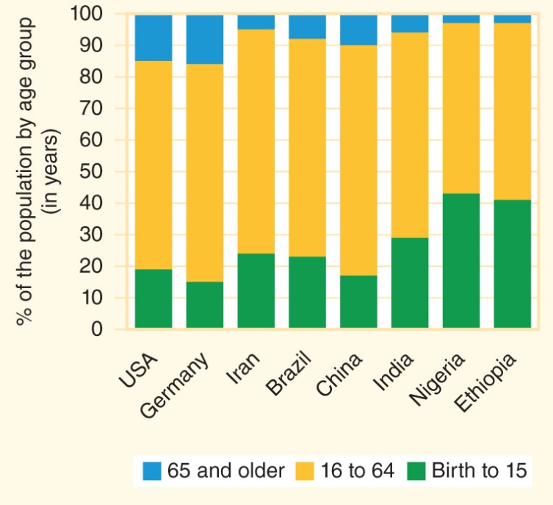
Figure 11-4
Data from 2016 world population data sheet. Washington: Population Reference Bureau (PRB); 2016.
Population by age group: higher-income countries have a high proportion of older adults and lower-income countries have a high proportion of children.

Slide 15
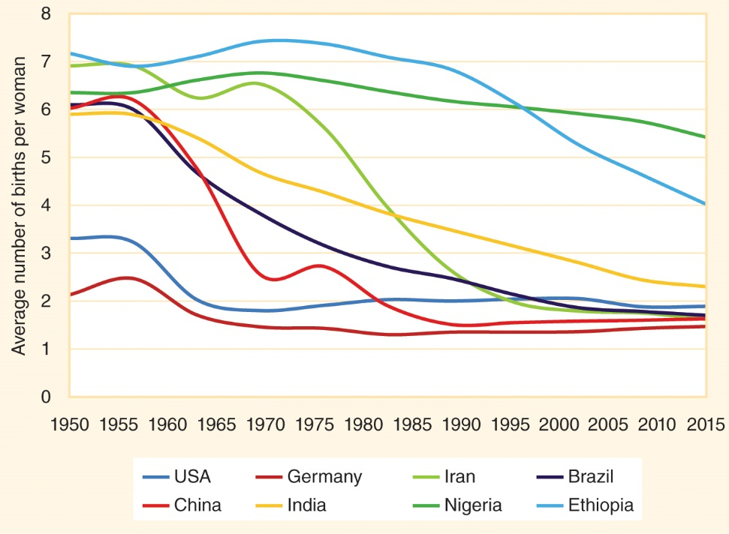
Figure 11-5
Fertility rates have decreased over time.

Slide 16
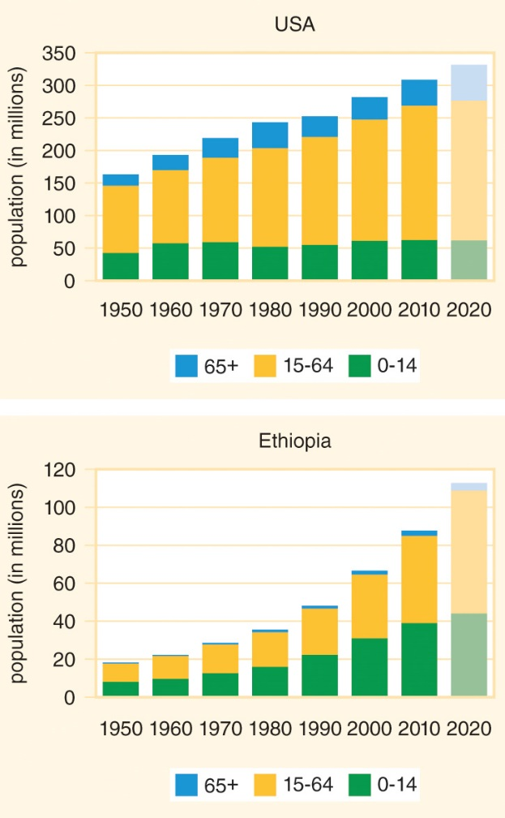
Figure 11-6
Data from United Nations Department of Economic and Social Affairs. World population prospects: The 2017 revision. New York: UN; 2017.
Population growth by age group.

Slide 17
Population Pyramids
A population pyramid displays the number of males and females by age group in a population.
Low-income countries usually have a population pyramid with a wide base of many children that gradually narrows in older age groups.
High-income countries often have low fertility rates that make the population “pyramid” look more like a rectangle or cube.

Slide 18
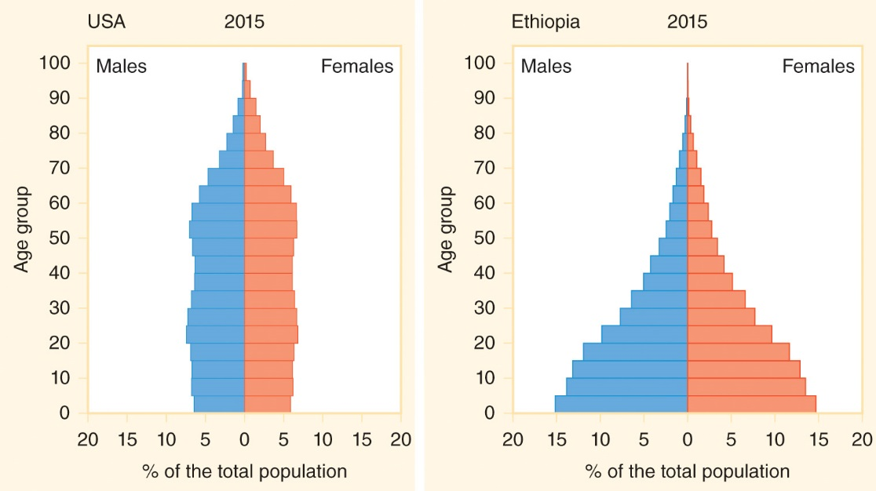
Figure 11-7
Data from United Nations Department of Economic and Social Affairs. World population prospects: The 2017 revision. New York: UN; 2017.
Examples of population pyramids (2015).

Slide 19
Population Planning
11.3

Slide 20
Population Planning
The goal of population planning policies is to promote a population growth rate in line with desired demographic and socioeconomic profiles.
In high-income countries where fertility rates have remained below replacement level for more than a generation and population aging is a major concern, the goal of population policies is to provide incentives for increased fertility.
Upper-middle-income countries generally view their growth rates as satisfactory, but there is considerable diversity in how population policies are framed and implemented.
In most low- and lower-middle-income countries, population policies focus on encouraging reduced fertility rates because population growth levels are considered to be too high.

Slide 21
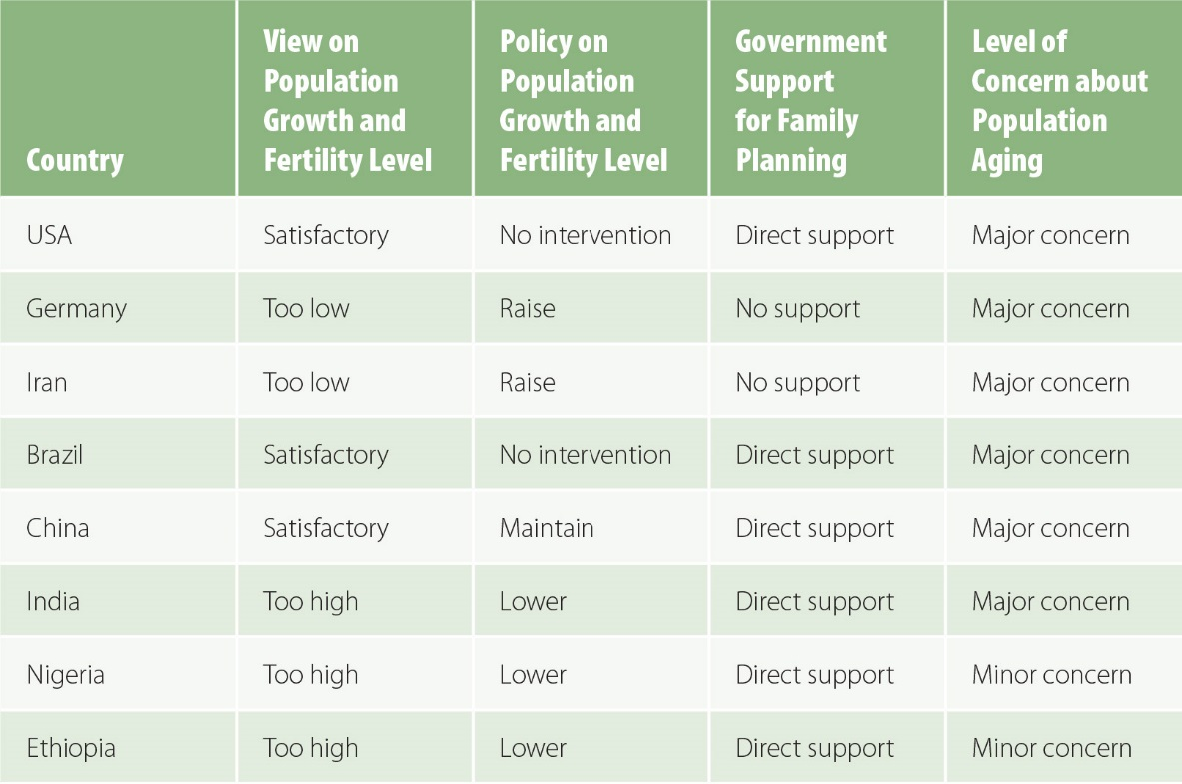
Figure 11-8
Data from United Nations Department of Economic and Social Affairs. World population policies 2013. New York: UN; 2013.
Population policies in featured countries.

Slide 22
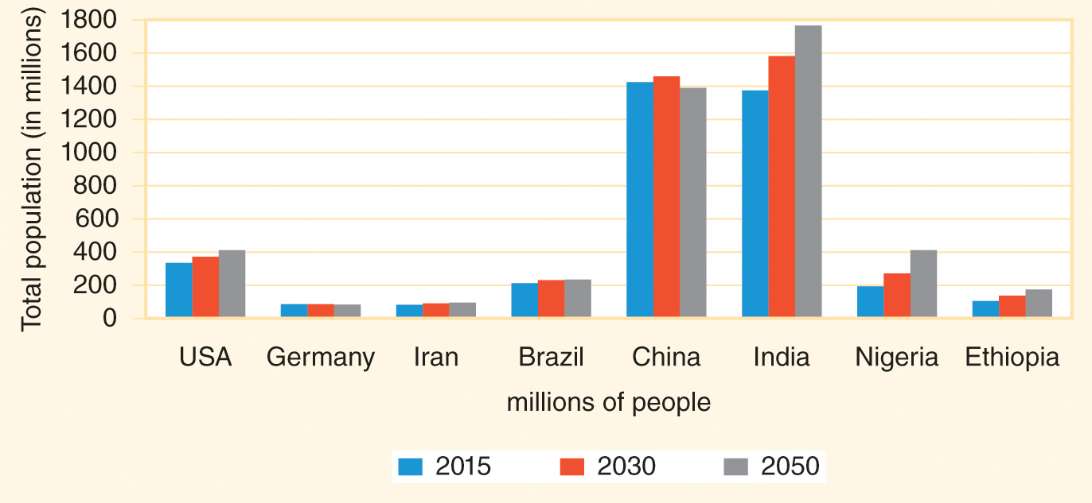
Figure 11-9
Data from 2016 world population data sheet. Washington: Population Reference Bureau (PRB); 2016.
Projections of population growth in selected countries.

Slide 23
Family Planning
11.4

Slide 24
Family Planning
All women and men of reproductive age need to have access to information about reproduction and contraception.
Family planning = a process by which women and men make informed decisions about how many children they want to have, how many years apart they want those pregnancies to be, and the actions they will take to achieve these goals.
Birth spacing = waiting until at least 2 years after the birth of one child before conceiving the next child.

Slide 25
Family Planning Methods
Abstinence = refraining from sexual intercourse and other types of genital contact.
Contraception = the intentional prevention of pregnancy.
Modern contraceptive methods include barriers, medications, and surgery.
  Condom = a physical barrier used to prevent sperm from coming into contact with an egg after sexual contact.
  Oral contraceptives (birth control pills) prevent ovulation when taken as prescribed.
  IUDs (intrauterine devices) prevent fertilization of eggs by creating a uterine environment that is unfavorable to sperm.
  Sterilization = the use of surgical or medical procedures to intentionally make it difficult or impossible for a person to reproduce.
Only abstinence and condoms help to prevent the spread of sexually transmitted infections (STIs).

Slide 26
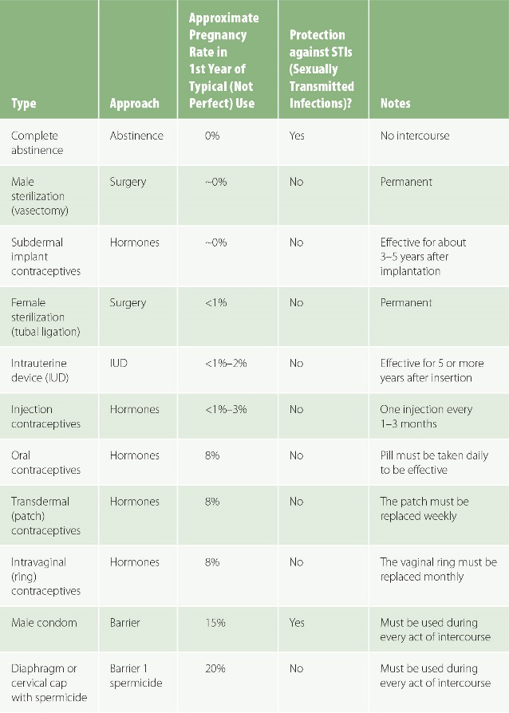
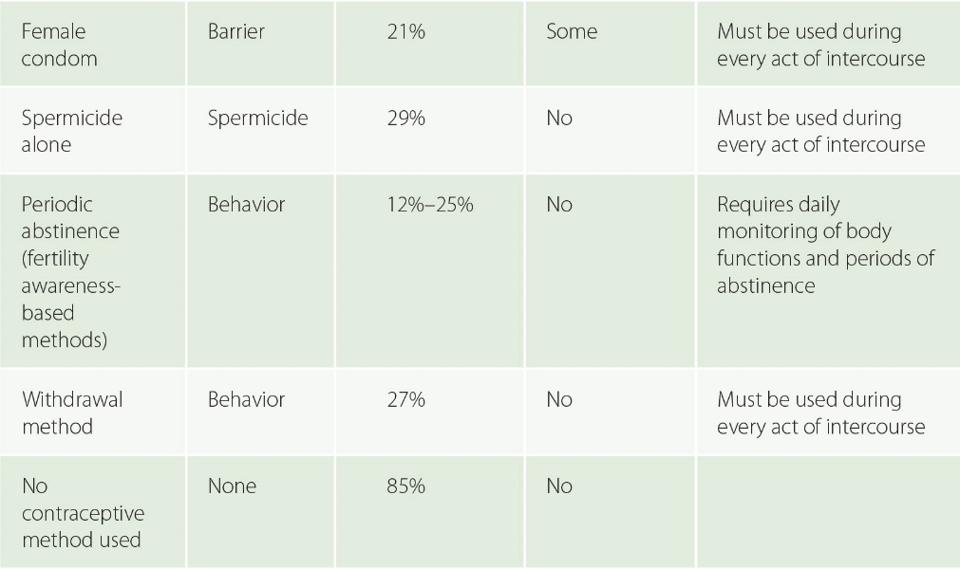
Figure 11-10
Data from Black KI, Gupta S, Rassi A, Kubba A. Why do women experience untimed pregnancies? A review of contraceptive failure rates. Best Pract Res Clin Obstet Gynaecol 2010; 24:443-55.
Contraceptive methods.

Slide 27
Abortion and Miscarriage
Abortion = the termination or loss of a pregnancy.
Spontaneous abortions = miscarriages.
Induced abortions = chemically or surgically terminated pregnancies.
Induced abortions are not a form of contraception, because they end a pregnancy rather than prevent it.
Increased access to contraception reduces the number of induced abortions by preventing unplanned pregnancies.

Slide 28
Access to Contraception
Many sexually active reproductive-age women and men around the world do not use any contraceptive method.
The SDGs aim to ensure that all “women of reproductive age (aged 15-49) have their need for family planning satisfied with modern methods” (SDG 3.7.1).
Millions of people who would like to use contraception still do not have access to family planning services.
Thousands of healthcare providers and partners are seeking to bring information and supplies to men and women worldwide who want to make informed reproductive decisions.

Slide 29
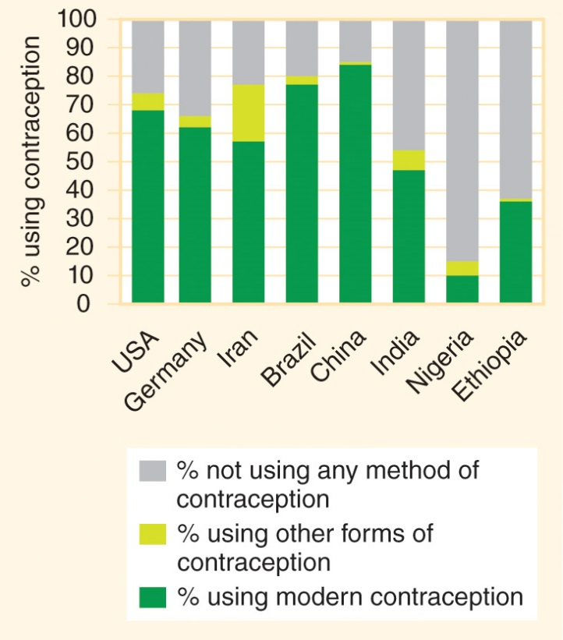
Figure 11-11
Data from 2016 world population data sheet. Washington: Population Reference Bureau (PRB); 2016.
Percentage of married and partnered women ages 15-49 years who are using modern contraception (such as condoms, the pill, sterilization, or an IUD).

Slide 30
Infertility
11.5

Slide 31
Infertility
Infertility = the inability to become pregnant when sexually active and not using contraception or the inability to maintain a pregnancy through to a live birth.
Primary infertility = infertility in a woman who has never had a live birth.
  About 2% of women who are 20- to 44-years-old have primary infertility after 5 years of attempting to conceive.
Secondary infertility = the inability to have additional offspring when attempting to conceive after having given birth to a child.
  About 10.5% of women who have had a live birth have secondary infertility.
More than 50 million couples worldwide with a female partner of childbearing age are unable to have a child after 5 years of attempting to become pregnant.

Slide 32
Infertility Treatment
Treatments for infertility include stimulation of egg production through medications, surgery to remove fibroids in the uterus and blockages in the fallopian tubes, medication or surgery to improve male reproductive function, and procedures like intrauterine insemination.
Assisted reproductive technologies (ART) = fertility treatments that handle eggs or embryos.
  In vitro fertilization (IVF) = a woman’s eggs are extracted from her ovaries, fertilized with sperm in a laboratory setting, and then the resulting embryos are transferred to the uterus.
  ART is costly even in high-income countries and is not widely available to residents of lower-income countries.

Slide 33
Healthy Pregnancy
11.6

Slide 34
Reproductive History
Most global health reports use fertility to measure pregnancies in a population.
  Gravidity = the total number of times a woman has been pregnant, including miscarriages, abortions, stillbirths, and live births.
  Fertility = the total number of births, whether the result was a stillbirth or a live birth.
  Parity = the total number of live births.
The goal of family planning is to minimize unplanned pregnancies (to reduce gravidity) and to maximize the health of babies from pregnancies that do occur (so that parity is as close as possible to gravidity).

Slide 35
Antenatal Care
Safe motherhood programs promote healthy pregnancies from the months prior to conception through the postpartum period.
Antenatal care (ANC) check-ups = prenatal care = routine preventive healthcare consultations during pregnancy that allow clinicians to identify and address potential health problems in a woman or fetus.

Slide 36
Pregnancy Problems
Hyperemesis gravidarum = severe nausea and vomiting in early pregnancy that causes severe dehydration and significant weight loss.
Ectopic pregnancy = a fertilized egg implants in the fallopian tubes or another location outside the uterus and the nonviable pregnancy puts the woman at risk of internal bleeding and death.
As the pregnancy progresses, women may require treatment for anemia, hypertension, gestational diabetes, and other conditions.
Placenta previa = the placenta covers part or all of the cervix and causes bleeding.
Placental abruption = the placenta separates from the uterine wall prior to delivery.

Slide 37
Childbirth
Complications can occur during any of the three stages of childbirth.
Stage 1: labor, when contractions dilate the cervix to about 10 centimeters in diameter.
Stage 2: delivery of the neonate.
Stage 3: delivery of the placenta, also called the afterbirth.

Slide 38
Birth Attendants
Skilled birth attendant (SBA) = an obstetrician or gynecologist, another type of physician, a nurse midwife, a nurse, or another trained person who can recognize and treat potential complications during and after labor and delivery.
One in four births worldwide occurs without the assistance of an SBA, including half of births in sub-Saharan Africa and South Asia.
Traditional birth attendant (TBA) = a lay midwife who has been trained through an apprenticeship rather than a formal educational program, who may be able to handle uncomplicated births but does not have the advanced training to safely manage complications.

Slide 39
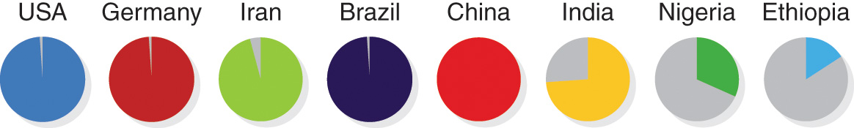
Figure 11-12
Data from World health statistics 2016. Geneva: WHO; 2016.
Proportion of births attended by skilled health personnel.

Slide 40
Emergency Obstetric and Newborn Care
A basic emergency obstetric and newborn care (BEmONC) facility can perform seven “signal functions”: providing pregnant women with (1) intravenous or injected antibiotics, (2) anticonvulsants, and (3) uterotonic drugs to help the uterus contract after delivery; (4) using forceps or vacuum extraction to assist with delivery; (5) removing the placenta manually and (6) removing retained products of conception with tools; and (7) performing neonatal resuscitation using a bag and mask.
A comprehensive EmONC (CEmONC) facility can provide all of the basic functions and also provide (8) blood transfusions and (9) perform Caesarean sections.

Slide 41
Caesarean Sections
Caesarean section (C-section) = a surgical delivery of a neonate through an incision in the mother’s abdomen and uterus.
  A C-section rate of about 10%, and no more than 15%, is associated with the lowest maternal death rate.
  A safe C-section is performed by an obstetrician or surgeon with the assistance of an anesthesiologist, but there are few medical specialists in low-income countries who are able to provide these services.
Postnatal care ensures that mothers are recovering well and babies are healthy.

Slide 42
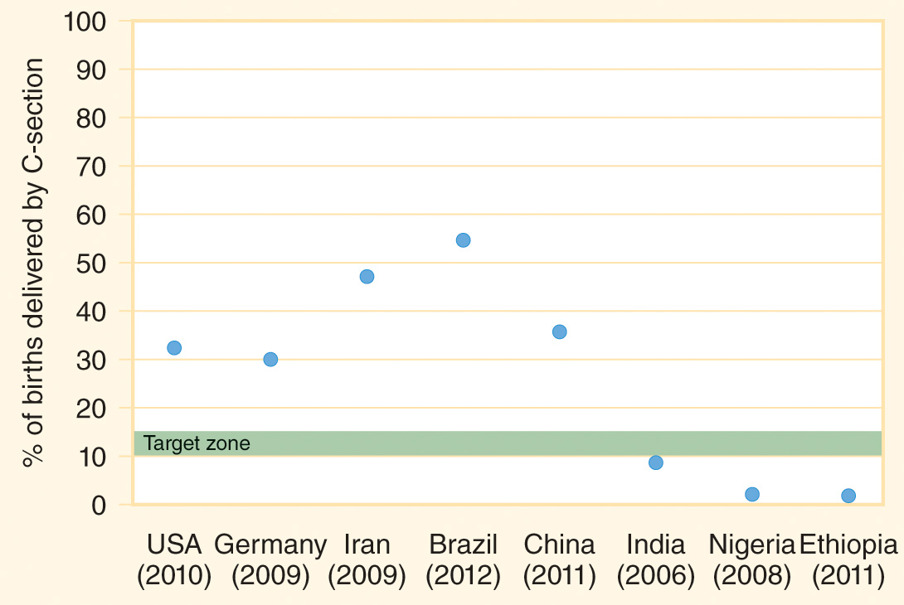
Figure 11-13
Data from Ye J, Zhang J, Mikolajczyk R, Torloni MR, Gülmezoglu AM, Betran AP. Association between rates of Caesarean section and maternal and neonatal mortality in the 21st century: a worldwide population-based ecological study with longitudinal data. BJOG 2016; 123:745-53.
Percentage of babies delivered by Caesarean section. The target range is about 10% to 15%.

Slide 43
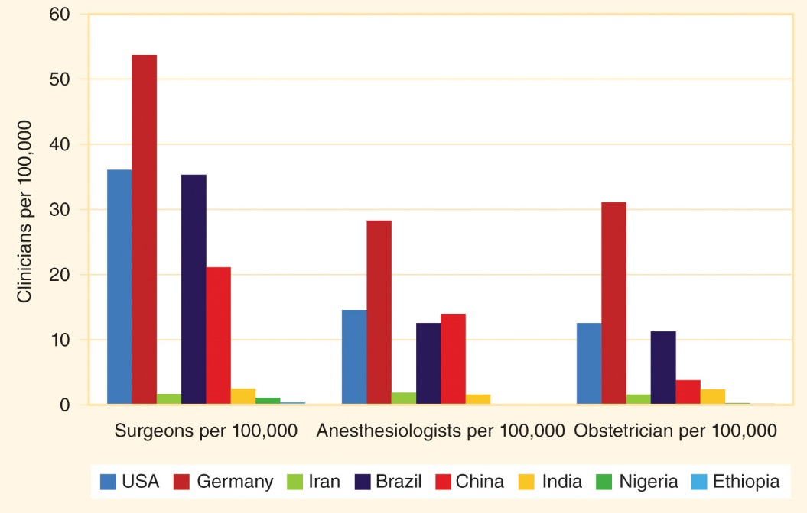
Figure 11-14
Data from Holmer H, Lantz A, Kunjumen T, Finlayson S, Hoyler M, Siyam A, et al. Global distribution of surgeons, anaesthesiologists, and obstetricians. Lancet Global Health 2015; 3(Suppl 2):S9-11.
Medical specialists per 100,000 population.

Slide 44
Maternal Mortality and Disability
11.7

Slide 45
Maternal Mortality
Maternal mortality = death of women from pregnancy-related causes during pregnancy, childbirth, or the 6 weeks after delivery.
In 2015, about 300,000 women died from maternal causes.
In 1990, about 500,000 women died from pregnancy-related causes.
Most of these maternal deaths could have been prevented through increased access to obstetric care and increased access to contraception for women who want to prevent pregnancy.

Slide 46
Maternal Mortality Rate
Maternal mortality rate (MMR) = the number of women who die of pregnancy-related causes per 100,000 live births.
One of the Millennium Development Goals (MDGs) was to reduce the global MMR by 75% between 1990 and 2015.
The MMR decreased from about 385 per 100,000 live births worldwide in 1990 to 215 per 100,000 in 2015, which was a 45% decrease that fell short of the MDG target.
The lifetime risk of dying in childbirth also decreased during this 25-year period, from about 1 in 73 in 1990 to 1 in 180 in 2015.

Slide 47
Millennium Development Goals
The SDG target (SDG 3.1) aims to reduce the MMR to less than 70 deaths per 100,000 live births.
  The vast majority of maternal mortality cases occur in low-income countries.
  Higher-income women experience a much lower mortality rate than lower-income women.
Obstetric transition = the shift from a high maternal mortality rate to a negligible rate that occurs with socioeconomic development.

Slide 48
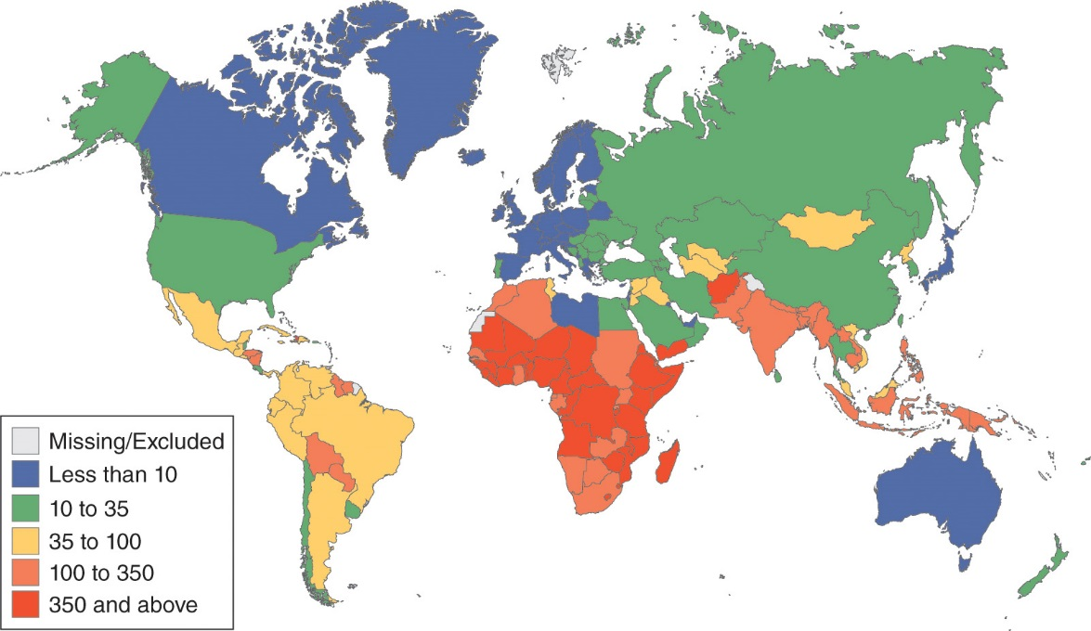
Figure 11-15
Data from Trends in maternal mortality, 1990 to 2015: Estimates by WHO, UNICEF, UNFPA, World Bank Group and the United Nations Population Division. Geneva: WHO; 2015.
Maternal mortality ratio per 100,000 live births (2015).

Slide 49
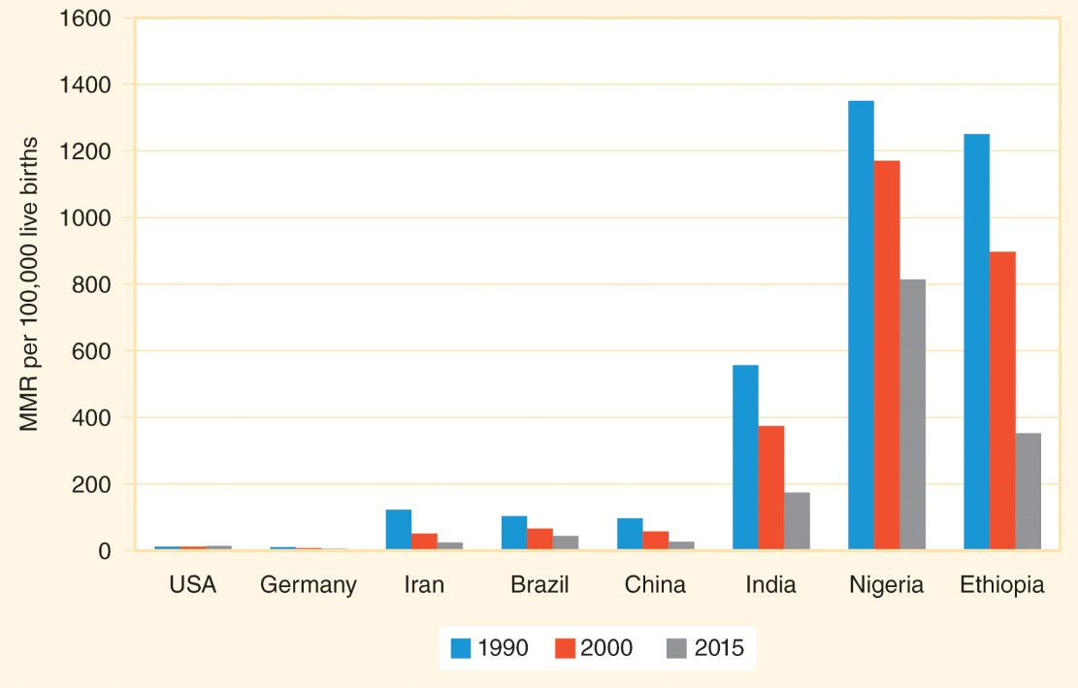
Figure 11-16
Data from Trends in maternal mortality, 1990 to 2015: Estimates by WHO, UNICEF, UNFPA, World Bank Group and the United Nations Population Division. Geneva: WHO; 2015.
The MMR per 100,000 live births has decreased significantly, but disparities remain.

Slide 50
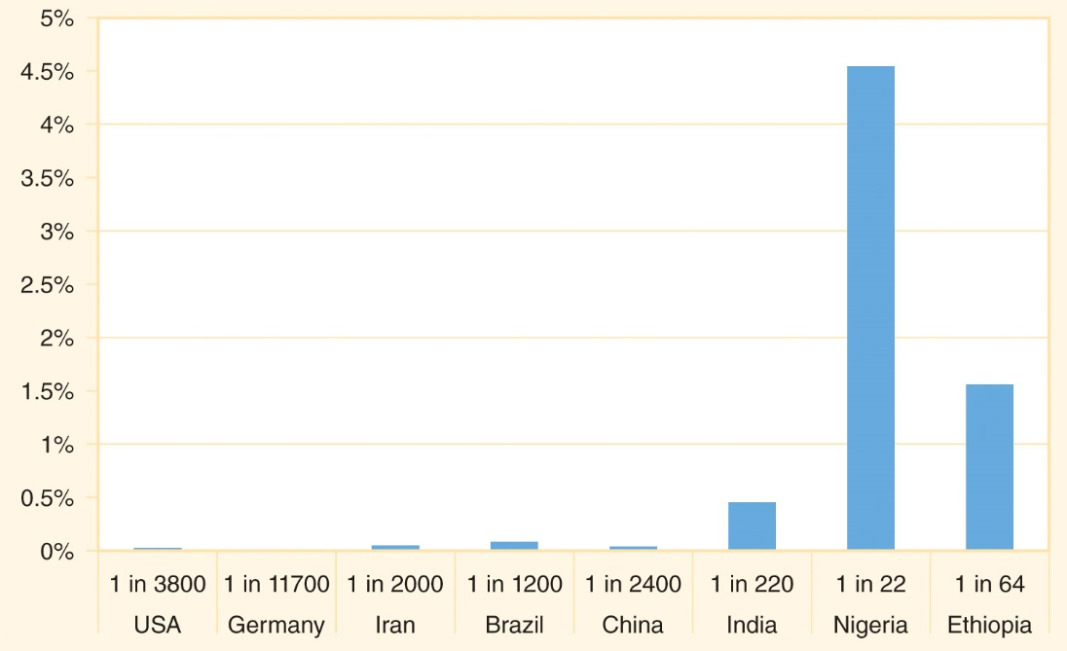
Figure 11-17
Data from Trends in maternal mortality, 1990 to 2015: Estimates by WHO, UNICEF, UNFPA, World Bank Group and the United Nations Population Division. Geneva: WHO; 2015.
Lifetime risk of maternal mortality.

Slide 51
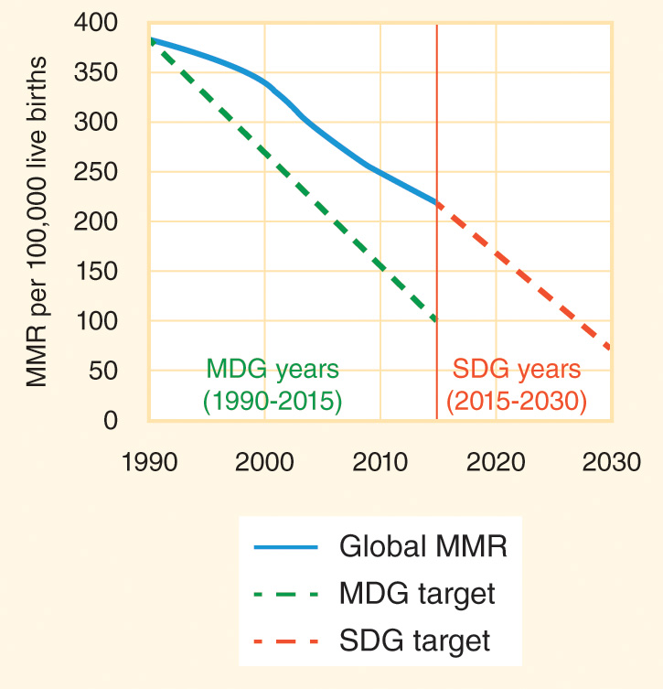
Figure 11-18
Data from Trends in maternal mortality, 1990 to 2015: Estimates by WHO, UNICEF, UNFPA, World Bank Group and the United Nations Population Division. Geneva: WHO; 2015.
The MDG target for maternal survival was not met.

Slide 52
Maternal Mortality Causes
The most common causes of maternal mortality are hemorrhage (severe bleeding), hypertension (dangerously elevated blood pressure), and sepsis.
Sepsis = “blood poisoning” = widespread inflammation in the body that is triggered by the chemicals released by body’s immune system in response to an infection that can lead to organ failure, shock, and death.
Postpartum hemorrhage = severe bleeding within several hours after giving birth.
  PPH can often be prevented through the active management of the third stage of labor (AMTSL), including injecting the hormone oxytocin after delivery.

Slide 53
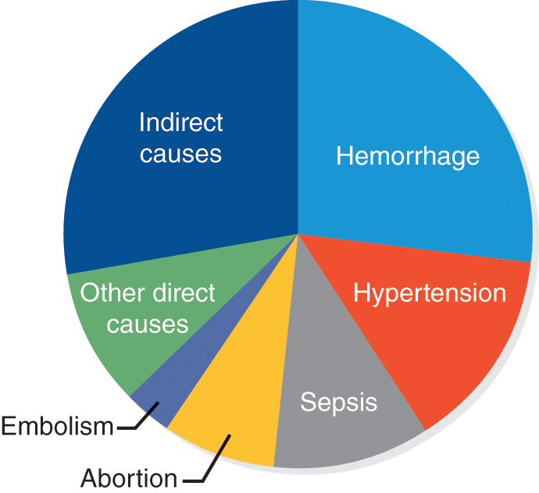
Figure 11-19
Causes of maternal mortality worldwide.

Slide 54
Preeclampsia
Elevated blood pressure can occur at any time during pregnancy.
Preeclampsia = worsening hypertension in the final months of pregnancy along with the presence of protein in the urine.
About 5% of pregnant women develop preeclampsia, and many of those pregnancies require preterm deliveries that carry health risks for the babies but are necessary for the survival and health of the mother.

Slide 55
Obstructed Labor
Women who survive pregnancy and delivery complications may be left with permanent disabilities.
Obstructed labor = the unborn baby is wedged so tightly into the birth canal that blood flow to surrounding tissues is cut off and the tissues start to die, sometimes forming an obstetric fistula.
  In nearly all of these cases, the baby is stillborn.
  Obstetric fistula = a hole between the rectum or bladder and the vagina that constantly leaks urine or feces.
  More than 1 million women worldwide are estimated to be living with an obstetric fistula that has not been surgically corrected.

Slide 56
Neonatal Health
11.8

Slide 57
Stillbirths
About 140 million babies are born each year, and the vast majority of these babies were born healthy.
Stillbirth = the death of a fetus late in pregnancy but prior to delivery, typically defined as occurring after the 28th week of gestation and after the fetus already weighs at least 2.2 pounds (1000 grams).
  There are about 18 stillbirths for each 1000 live births, for a total of more than 2.5 million stillbirths worldwide.
  In many cases there is no identifiable reason for the stillbirth.
Perinatal mortality = stillbirths and deaths within the first 7 days (1 week) after a live birth.

Slide 58
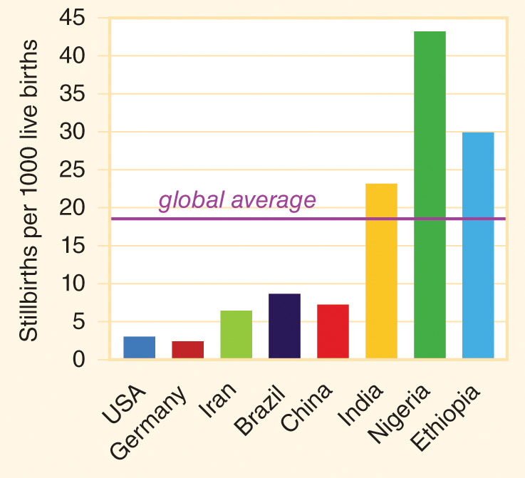
Figure 11-20
Data from Blencowe H, Cousens S, Jassir FB, Say L, Chou D, Mathers C, et al. National, regional, and worldwide estimates of stillbirth rates in 2015, with trends from 2000: a systematic analysis. Lancet Glob Health 2016; 4:e98-108.
Stillbirth rate per 1000 live births.

Slide 59
Age Groups
Neonate = a newborn within his or her first 28 days (4 weeks) after birth.
Infant = a baby between birth and the first birthday.
Under-5 child = a child between birth and the fifth birthday.

Slide 60
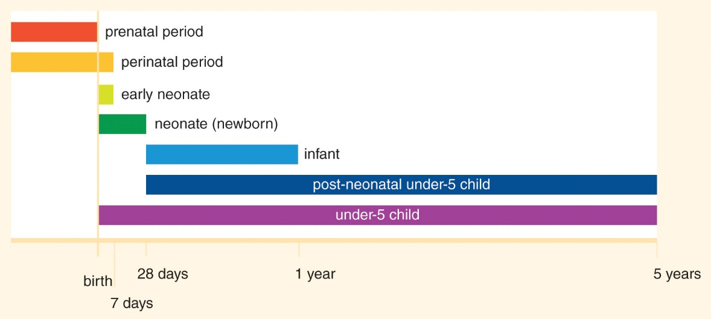
Figure 11-21
Age groups in early childhood.

Slide 61
Neonatal Mortality
The first week after birth accounts for more than one-third of all under-5 mortality.
Neonatal deaths currently account for about 45% of all under-5 child mortality.
Of the two million neonates who died worldwide in 2015, about 1/3 of the deaths were attributed to preterm delivery, 1/3 to birth traumas such as asphyxia, and 1/3 to infections and other causes.

Slide 62
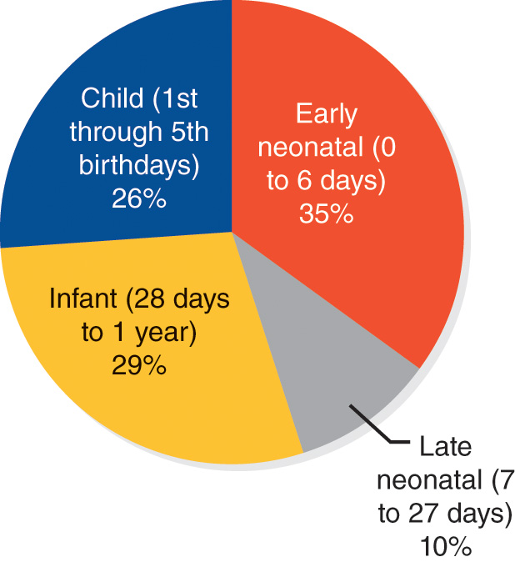
Figure 11-22
Data from GBD 2015 Child Mortality Collaborators. Global, regional, national, and selected subnational levels of stillbirths, neonatal, infant, and under-5 mortality, 1980–2015: A systematic analysis for the Global Burden of Disease Study 2015. Lancet 2016; 388(10053):1725-74.
Neonates account for a large proportion of all under-5 child mortality

Slide 63
Neonatal Mortality Rate
Neonatal mortality rate (NMR) = the number of deaths of neonates per 1000 live births.
  The global NMR in 2015 was about 19 per 1000 live births, with a lower rate in high-income countries and a higher rate in low-income countries.
  The SDGs aim to “end preventable deaths of newborns by lowering the NMR in all countries to at least as low as 12 per 1000 live births” (SDG 3.2).

Slide 64
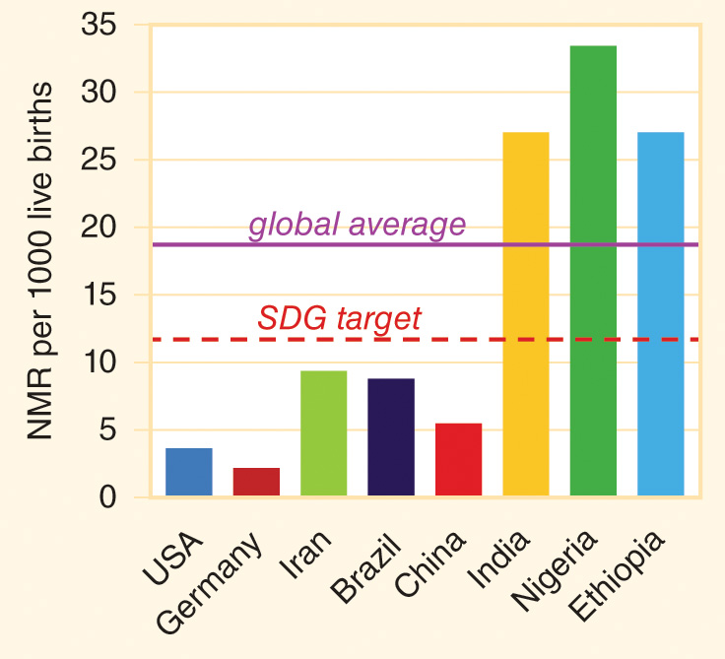
Figure 11-23
Data from World health statistics 2016. Geneva: WHO; 2016.
Neonatal mortality rates per 1000 live births.

Slide 65
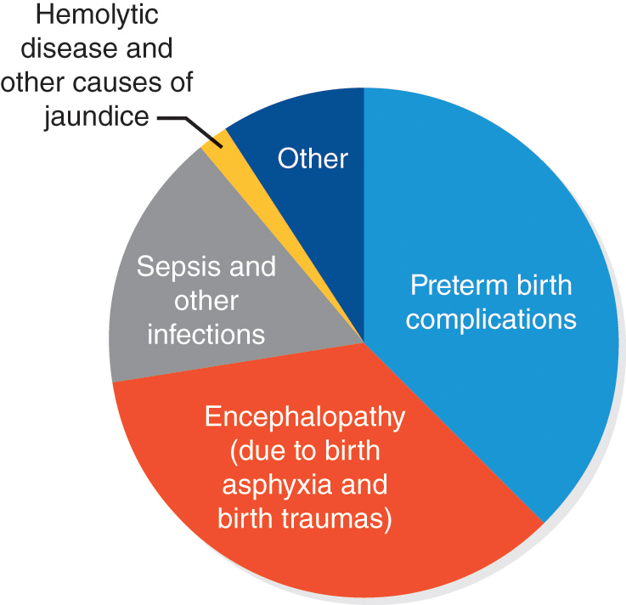
Figure 11-24
Data from GBD 2015 Child Mortality Collaborators. Global, regional, national, and selected subnational levels of stillbirths, neonatal, infant, and under-5 mortality, 1980–2015: a systematic analysis for the Global Burden of Disease Study 2015. Lancet 2016; 388(10053):1725-74.
Causes of neonatal mortality.

Slide 66
Preterm Birth
A typical pregnancy is about 40 weeks long.
Preterm birth = the delivery of a baby before the 37th week of pregnancy.
About 10% of babies are born prematurely, which results in about 15 million preterm babies being born each year.
More than 1 million of these preterm babies die at a young age.

Slide 67
Preterm Birth (cont’d)
Survivors, especially those with very low birthweights, may have long-term special needs.
In resource-limited settings, the survival of preterm babies is enhanced by skin-so-skin contact between a mother and newborn, frequent breastfeeding, and early discharge from the hospital to reduce the risk of infection.

Slide 68
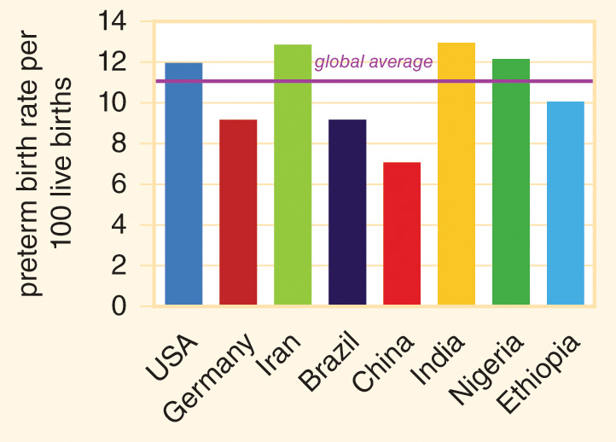
Figure 11-25
Data from Blencowe H, Cousens S, Oestergaard MZ, Chou D, Moller AB, Narwal R, Adler A, Vera Garcia C, Rohde S, Say L, Lawn JE. National, regional, and worldwide estimates of preterm birth rates in the year 2010 with time trends since 1990 for selected countries: a systematic analysis and implications. Lancet 2012; 379:2162-72.
Preterm birth rate per 100 live births

Slide 69
Low Birthweight
Low birthweight (LBW) = weighing less than 5.5 pounds (2500 grams) at birth.
The overall prevalence of LBW, including both preterm and full-term infants, is about 16%.
LBW babies have an increased risk of neurodevelopmental difficulties.
About 1 in 400 newborns has cerebral palsy (CP), a neuromuscular disorder.

Slide 70
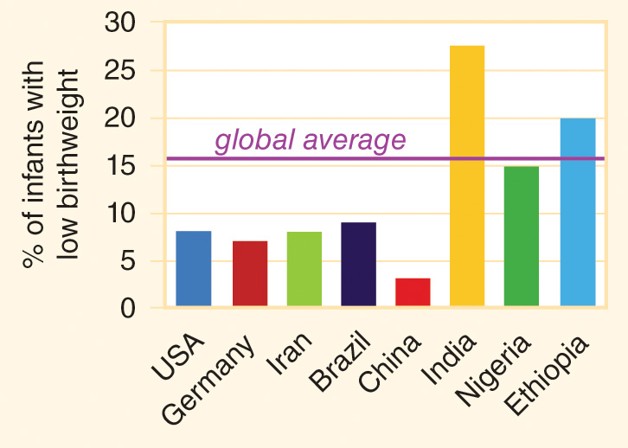
Figure 11-26
Data from State of the world’s children 2016. New York: UNICEF; 2016.
Percentage of infants with low birthweight (less than 2500 grams at birth).

Slide 71
Other Causes of Neonatal Mortality
Birth asphyxia occurs when a full-term newborn fails to take a first breath immediately after delivery and is therefore deprived of oxygen.
A variety of infections can be fatal for newborns.
Tetanus is an infection of special concern when babies are born in unclean environments (such as homes with dirt floors).
  Tetanus = a sustained muscle contraction.
  Neonatal tetanus interferes with feeding and causes a significantly likelihood of death.
  Maternal immunization with tetanus toxoid prior to delivery confers protection on mothers and newborns.

Slide 72
Neonatal Survival
Neonatal survival begins with universal access to prenatal care and intrapartum care provided by skilled birth attendants.
After birth, routine care for newborns includes keeping them warm, providing breastfeeding at regular intervals starting soon after birth, and preventing infections through handwashing and hygienic cord care.
Babies with breathing difficulties, signs of infection, jaundice, or other problems require clinical treatment.

Slide 73
Gynecologic Health
11.9

Slide 74
Gynecologic Health
Premenstrual syndrome (PMS) = the physical discomfort, depressed mood, and other symptoms caused by hormonal changes during a menstrual cycle are severe enough to interfere with usual daily activities.
Fibroids = benign tumors in the uterus that can cause heavy bleeding and pelvic pain.
Endometriosis = the tissue that lines the uterus is located on the ovaries or in other parts of the abdominal cavity, and it bleeds with each menstrual cycle, often causing pain and resulting in the formation of scar tissue and adhesions.
Women are at risk of a diversity of cancers of the reproductive system, sexually transmitted infections, benign breast diseases, sexual dysfunctions, and gender-based violence.

Slide 75
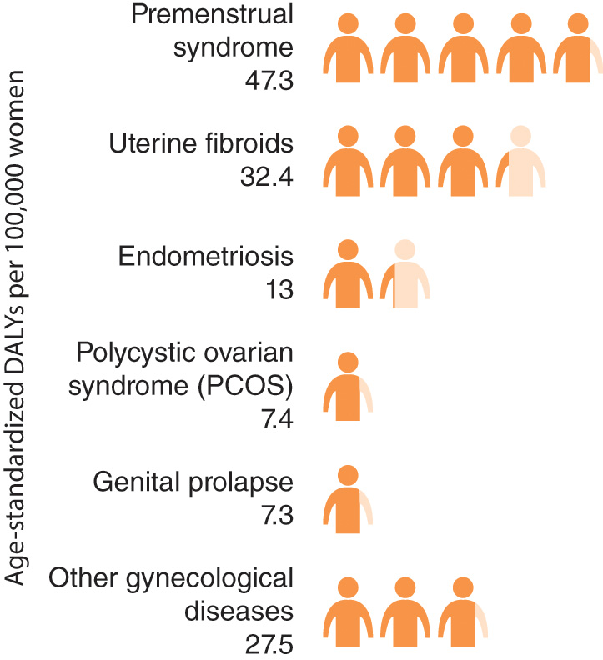
Figure 11-27
Data from GBD 2015 DALYs and HALE Collaborators. Global, regional, and national disability-adjusted life-years (DALYs) for 315 diseases and injuries and healthy life expectancy (HALE), 1990–2015: a systematic analysis for the Global Burden of Disease Study 2015. Lancet 2016; 388:1603-58.
Age-standardized disability-adjusted life years (DALYs) lost to gynecological diseases per 100,000 women (excluding cancers and pregnancy-related conditions).

Slide 76
Men’s Reproductive Health
11.10

Slide 77
Men’s Reproductive Health
Testicular cancer occurs very infrequently, but it peaks in prevalence in younger men.
Benign prostatic hyperplasia (BPH) = enlargement of the prostate gland that is very common among older men.
Erectile dysfunction (ED) may occur as a result of a variety of health conditions.
Men of all ages may have concerns about sexually transmitted infections, infertility, and other sexual health issues.

Slide 78
Sexual Minority Health
11.11

Slide 79
Sexual Minority Health
Members of sexual and gender minority groups often have difficulty accessing high-quality health services.
Health and social service workers need to understand the various aspects of sexuality and gender and use appropriate terms when working with diverse clients.
The SDGs cannot be achieved when sexual and gender minority and majority populations do not have equal access to health and safety.

